Slide 1
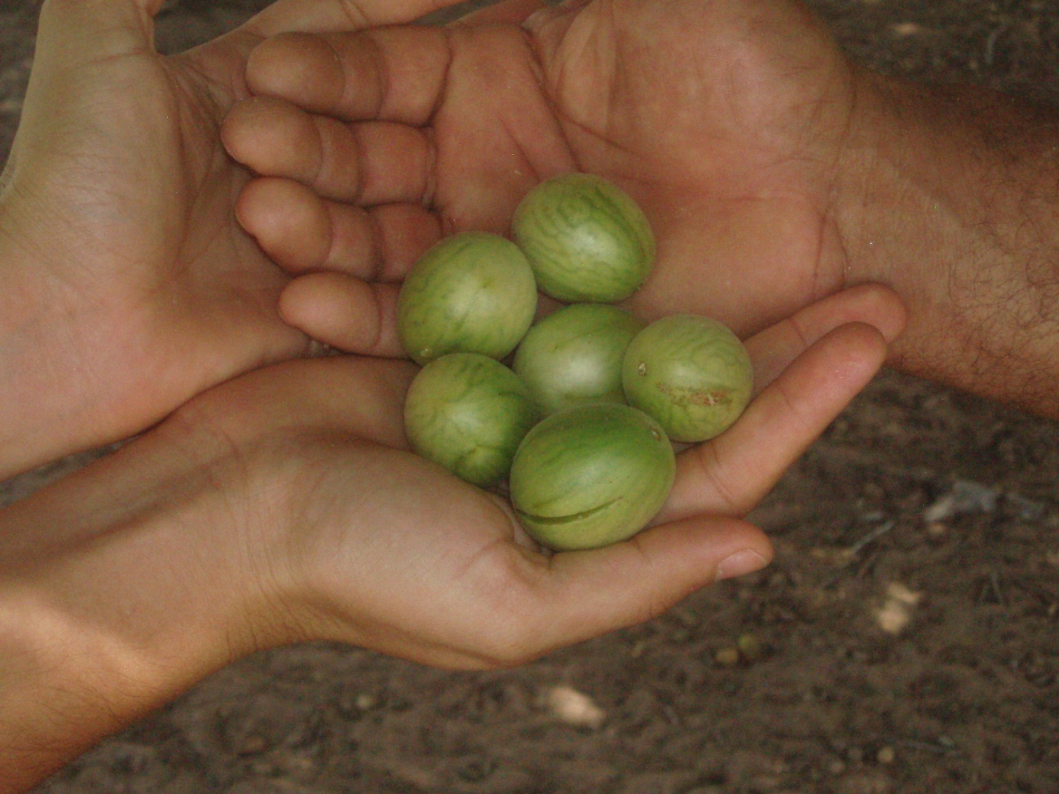
5th National Report to the CBD 2014

Slide 2
Preparation process February – October 2014
Hired two consultants
Sent questionnaire and analyzed received information
Researched the internet for additional information
Prepared the document’s structure and organized information
...
Notes:
Enviado para a Conabio em 16/07 para comentários até 23/07, em 12/08 para comentários até 20/08, e nova versão incorporando comentários em 02/09.

Slide 3
Preparation process – cont.
...
5. Specific consultations to complement information
6. Request for comments on the document and for additional contributions - MMA, other collaborators (Jul-Ago); Conabio (16/Jul and 12/Aug)
7. Document discussed by Conabio 17 and 18/Sep
8. Conclusion of the final version w/ contributions from Conabio and approval of document (29/Sep)

Slide 4
Structure and contents
Part I: An update of biodiversity status, trends and threats and implications for human well-being
1.1 Introduction
1.2 Update on biodiversity status and trends
1.3 Main threats to biodiversity
1.4 Main actions to protect biodiversity
1.5 Impacts 0f the changes in biodiversity

Slide 5
Structure and contents
Part II: The national biodiversity strategy and action plan
2.1 Status and updating of the Brazilian NBSAP
2.2 Integration of biodiversity in sectoral strategies, plans and programs

Slide 6
Structure and contents
Part III: Progress towards the 2015 and 2020 Aichi Biodiversity Targets and contributions to the relevant 2015 Targets of the Millennium Development Goals
3.1 Progress toward the National and Aichi 2020 Biodiversity Targets
3.2 Progress toward the Millennium Development Goals
3.3 Lessons learned with the implementation of the CBD

Slide 7
Main conclusions...
Rio+20 (2010): increased awareness, engagement of other sectors, 100 Heads of State
2011: Dialogues on Biodiversity – broad participatory process
2013: new National Biodiversity Targets
2014: PainelBio, indicators for the targets, updating NBSAP

Slide 8
...Main conclusions
2014: With 6 years remaining to 2020, Brazil in general obtained progress toward the National Biodiversity Targets (preliminary assessment)
Progress was more expressive toward targets 5, 7, 11, 15 and 19 (Amazon +)
To achieve targets, Brazil needs to continue its efforts to: generate knowledge and capacity; improve environmental monitoring and enforcement systems; integrate biodiversity into sectoral policies and programs; increase scale of current actions.

Slide 9
National Targets
We are currently at an intermediary stage toward target achievement (2020)
4RN: target period had closed (2010)
Current process to update NBSAP:
- Structuring the PainelBio
- Definition of indicators
- Governmental Action Plan
- Development of the strategy for resources mobilization

Slide 10
Intermediary assessment of progress toward the
National Biodiversity Targets
Prior to the definition of monitoring indicators
Predominantly qualitative criteria

Slide 11
Degree of progress

Slide 12
Awareness increasing for the past 20 years
Dissemination efforts > since 2010 (federal and state government, private sector)
Scientific data made available
Polls: Brazil with good awareness level
Notion of biodiversity importance still incipient
Reach of awareness still needs greater scale
Notes:
Foi obtido um avanço moderado, já que diversas iniciativas foram implementadas ou estão em curso, em diferentes setores, para melhorar a definição de valor da biodiversidade, e para aumentar a sensibilização sobre o tema, mas os resultados dos esforços de valoração são ainda limitados, assim como o alcance das iniciativas de sensibilização.

Slide 13
Various policies, programs – ZEE, Map of Priority Areas, Payment for Environmental Services, Water Producer Program, certification of products
Private sector, EEB
Concept of sustainable production and consumption
Valuation still incipient
Incorporation into national accounting still limited
Notes:
PES muito incipiente, integração ainda muito baixa nas contas.

Slide 14
New positive incentives implemented – Green Protocol, Ecological ICMS in various states, Low Carbon Agriculture Plan, Resolution CMN 3.545/2008, Green Stipend, Forest Stipend, CAR (also sinking credit lines to environmental regularization), Central Bank Resolution requiring all financial institutions to adopt an environmental policy and establish in-house teams to enforce compliance
On-going definition of concepts
Pre-assessment indicates that some sectors still maintain perverse incentives to be overcome (IPI rebate for cars; diesel oil subsidies for fishing vessels; permission to import agricultural chemicals not yet approved in the country)
Notes:
Resolução CMN (Conselho Monetário Nacional) 3.545/2008 restringe crédito aos produtores que não cumprem a legislação ambiental na Amazônia.
Negativos: IPI reduzido para compra de carros; incentivos de pesca (atividades pesqueiras, espécies exóticas na aquicultura)
Demanda de mercado e crédito fácil: incentivos para expansão agrícola. MAPA está trabalhando sobre o crédito fácil.

Slide 15
Development of important initiatives and policies (government, private sector) – A3P, Action Plan for Sustainable Production and Consumption, Brasil Maior, National Policy on Solid Waste, MEBB
Degree of implementation and achievement still insufficient

Slide 17
Target 5 – Rate of habitat loss
Improvement of monitoring systems
Some states monitoring vegetation cover – AM, ES
In general, deforestation is lower
Deforestation is still high in Amazon, Cerrado
Estimate: land use, rate of degradation, fragmentation still not known, nor significantly reduced in all biomes
Data still being revised to allow assessment of target achievement

Slide 19
Target 6 – Sustainable use of aquatic biodiversity
Creation of REVIMAR
Legal instruments and regulations on fisheries, by-catch
Action Plans for threatened species and marine-coastal ecosystems
Important information gaps on fisheries resources and monitoring
Significant challenges to achieve sustainability
Existing data show over-exploitation

Slide 21
Target 7 – Sustainability of agriculture, extractive activities, aquaculture
Efforts to seek sustainability in small- and medium-scale agriculture, extractive activities, forest management
Implementation of the Rural Environmental Register and other rulings under the new Law on the Protection of Native Vegetation
Policies, initiatives – Operação Arco Verde; PGPMBio; PAA; PNEA; Plano ABC; environmental licensing of aquaculture operations w/ priority given to RESEX
Increase in certification of forest management (silviculture) operations
Consumption of agricultural chemicals (need to revise licensing procedure so that the tax payer is not penalized with the cost of assessment process) – MAPA informs that use of chemicals has changed: the use of class 5 has dropped and the use of class 1 has increased. However, inadequate use is still significant.
Current model finances research on products that are adequate for environmental licensing in countries that export to Brazil products that are unacceptable.
Aquaculture – lack of information; large risk of invasion by alien species
Limited reach of pro-sustainability policies
Adoption of sustainable practices growing, but still limited
Notes:
Meta nacional pede apenas a disseminação e fomento para incorporação de práticas sustentáveis. Meta de Aichi pede que todas as áreas de agricultura, aquicultura, e manejo florestal estejam sendo manejadas de forma sustentável.

Slide 22
Progress in sanitation with PAC
Law on solid waste
High inadequate use of agricultural chemicals (lack of awareness, lack of enforcement) and high consumption. Inadequate governance and licensing process to avoid approval of inadequate products.
Precarious monitoring systems, data gaps
15.2% of main rivers still face critical conditions
Heterogeneous geographical distribution, with many municipalities still without sanitary landfills, precarious collection systems, particularly in the N and NE
Antibiotics – inadequate disposal and insufficient capacity of the sanitation system to treat hormones and antibiotics

Slide 23
Progress in the identification of invasive species and invasion pathways
Some localized initiatives to control some species (European wild boar, golden mussel)
Proposal for official lists of invasive species
Implementation of National Strategy with no significant advances

Slide 24
Monitoring of conservation status of coral reefs - ReefCheck Brasil
Large portion of coral reefs and mangroves in protected areas
Improvement in management of coral reefs and mangroves in APAs, focusing on sustainable use
Invasion by Sun Coral, resulting in the exclusion of native spp.
Lack of information on impacts from climate change – risk, mitigation, etc ...
Assessment of the effectiveness of coastal management (land use and occupation in the coastal zone, waste, etc...)

Slide 26
Target 11 – Protected Areas
Creation of CAR
ARPA 3 Program – 60 million hectares and US$215 million
Change in the categories accounted for achieving the target
Evolution of the process for protected areas creation – representation, reduction of land tenure conflicts and SNUC implementation
GEF Marine Protected Areas project approved for expanding marine and coastal PAs to 5% in the next 4 years
Data and criteria still not available to allow assessment of target achievement (APP, RL, TI)
Effective PA management, habitat connectivity, ecosystem representation in biomes other than the Amazon
Low PA creation in coastal and marine region
Notes:
Meta de Aichi faz referência a 17% de áreas terrestres e águas continentais; e 10% de áreas marinhas e costeiras

Slide 27
Huge effort to assess conservation status of Brazilian species
Increase in the number of conservation action plans
Creation of Pro-Species – recognition of degrees of extinction risk for species and definition of roles
Increase in the number of threatened species

Slide 28
Progress in ex-situ conservation, research – larger germplasm bank in Latin America
Governmental acquisitions and Projects (BFN, Plants for the Future, botanical gardens, zoos)
On-farm initiatives
Data gaps on in-situ conservation in protected areas
Strengthening of production chains using species from Brazilian biodiversity
Increase in the conservation of genetic diversity on farm, in situ and ex-situ - higher diversity

Slide 29
Creation of instruments Law 12.651/2012
PES programs
Policies w/ incentives for maintenance of forests, needs of traditional/indigenous communities – GATI, PGPMBio, payment for ecosystem services, PNPSB, PNPCT
PPCDAm, PPCerrado, Atlantic Forest Pact
Implementation of Law 12.651/12 still initiating
Reach of PES programs and policies still limited
Notes:
PNPCT – Política Nacional de Desenvolvimento Sustentável dos Povos e Comunidades Tradicionais; PNPSB – Política Nacional de Promoção das Cadeias de Produtos da Sócio-biodiversidade

Slide 31
Target 15 – Ecosystem resilience, restoration and conservation
Proposal for a national plan for the restoration of native vegetation, under discussion
Assessment of the economics of forest restoration
Implementation of CAR and CRA
PPCDAm, PPCerrado, Atlantic Forest Pact
Restoration of at least 15% of degraded ecosystems

Slide 32
Brazil has a legal framework for ABS that responds to the Protocol
Updating of legal framework under discussion in Congress
Brazil signed the Protocol
Government presented a request for Protocol ratification to Congress
Congress created a special commission for ratification (not yet established)
Protocol undergoing the process for ratification

Slide 33
Dialogues on Biodiversity
Definition/approval of new National Targets
Creation of PainelBio
On going definition of indicators
Governmental Action Plan for the Conservation and Use of Biodiversity at final discussion phase
(Some) Sub-national initiatives
Process to update NBSAP still on-going

Slide 35
Target 18 – Traditional knowledge
Progress in capacity building, organization and participation of indigenous/traditional communities
Several policies, initiatives and projects being implemented – decree 6.040/2007, policies to safeguard and protect immaterial heritage under MINC (includes associated traditional knowledge)
Brazil already has a legal framework to protect traditional knowledge from improper use
Use of biological resources under common law respected in legislation
Updating of legal framework under discussion in Congress
Proposal broadens the rights of traditional peoples and communities regarding associated traditional knowledge
Complete and effective participation, at all levels

Slide 37
Target 19 – Scientific basis
Many examples of progress in information generation and creation of databases – SiBBr, Sisbiota, Flora Catalogue and Virtual Herbarium
Flora on line and Fauna Catalogue in preparation
Large amount of data already made available
Integration of databases, access
Information gaps (particularly on the consequences of the loss of biodiversity)

Slide 38
Ongoing preparation of a national strategy for resources mobilization and capacity
Assessment of capacity needs; take the necessary steps to put in place the necessary capacity
Assessment of the gaps of resources and Plan for mobilizing financial resources

